Slide 1
Building new boxes

Slide 2

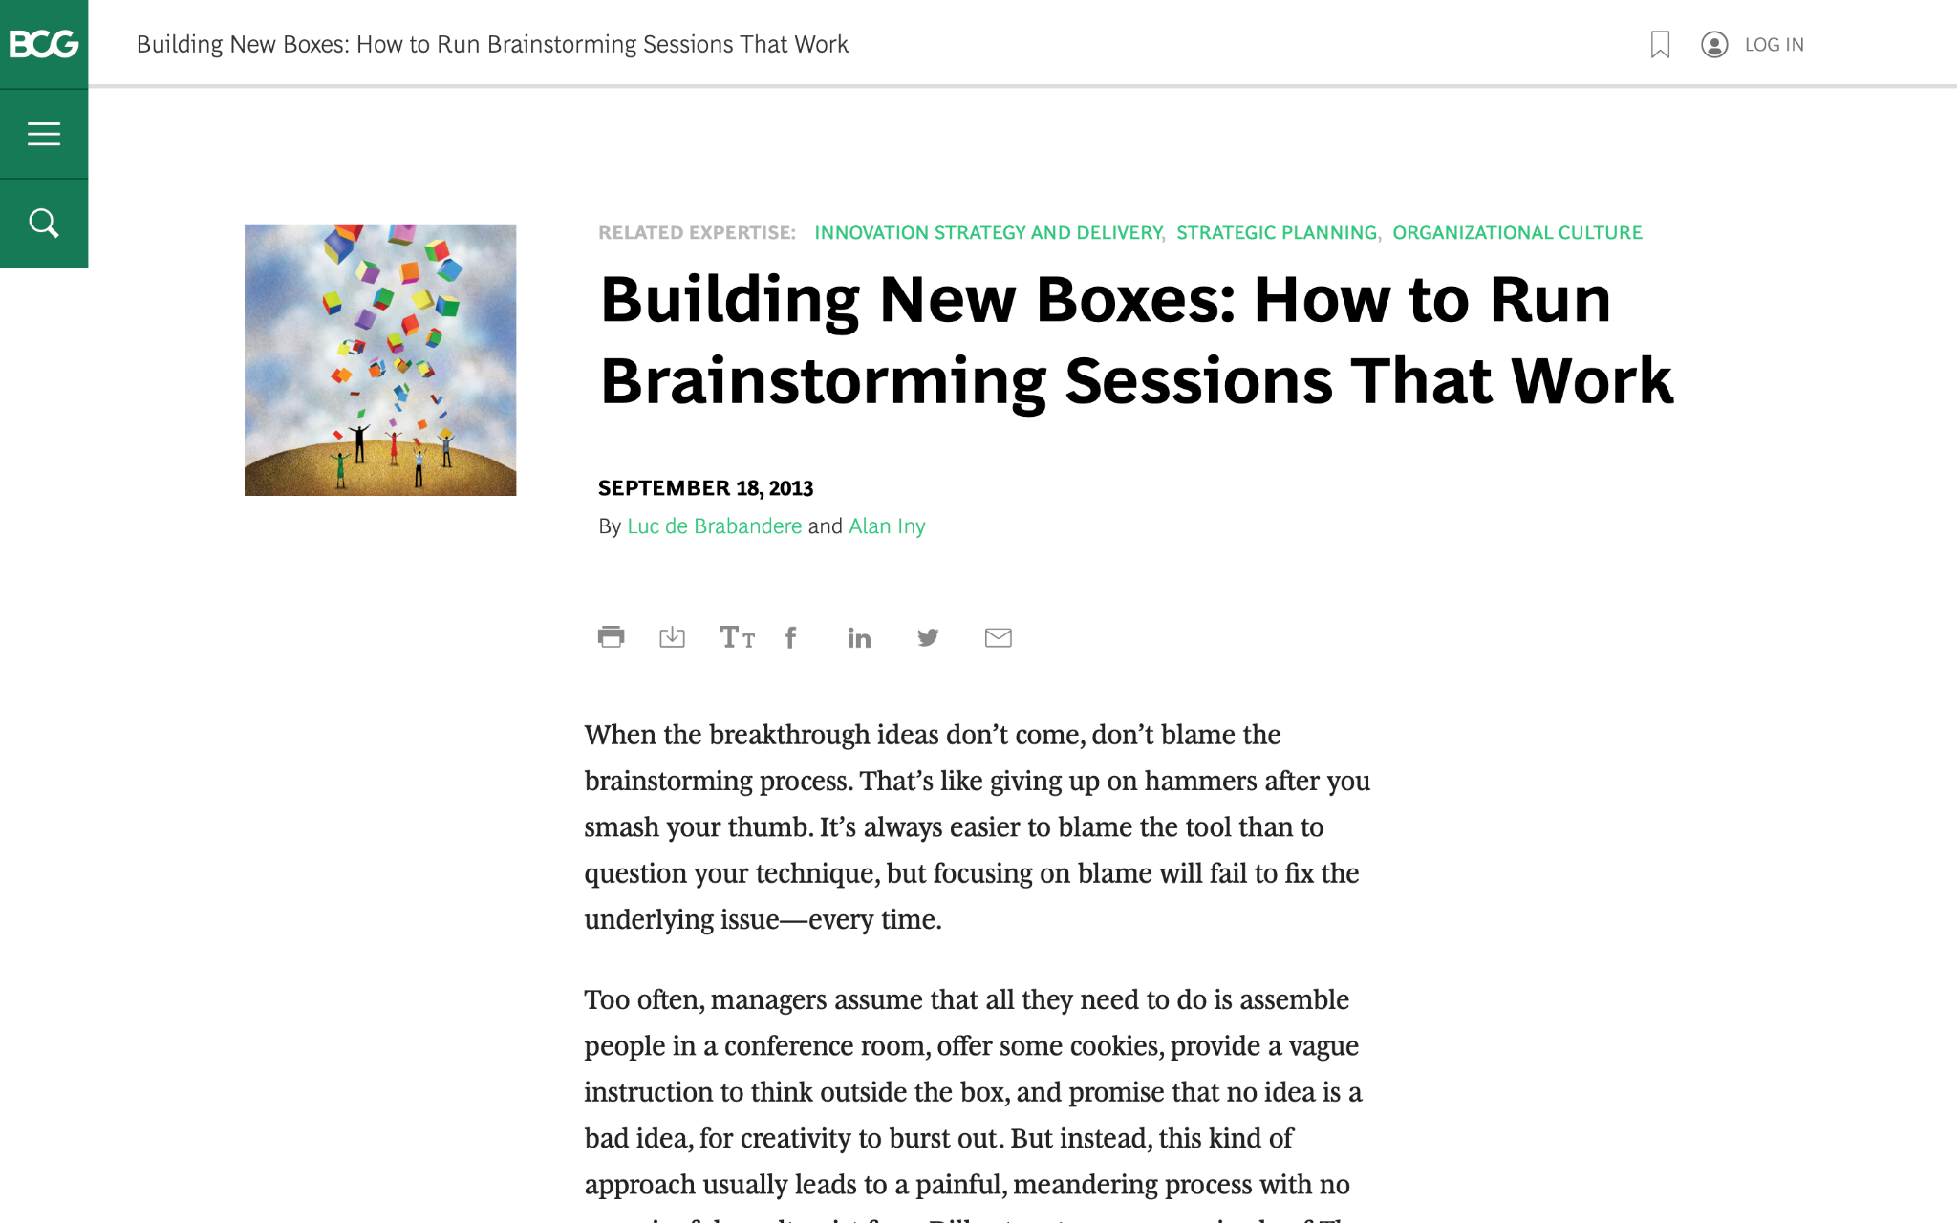
We are going to discuss effective brainstorming. Start by reviewing this article on the BCG website:
Building New Boxes: How to Run Brainstorming Sessions That Work

Slide 3

The article offers five suggestions to achieve real, valuable insights from brainstorming
We will focus on three of these in today’s task (as well as the brainstorming itself), highlighted in green
1.
Frame the question effectively
2.
Create creativity conditions
3.
Reveal and doubt your boxes
4.
Bring new boxes
5.
Follow up
Brainstorm

Slide 4

Your task
BCG has been brought in to help ClothingCo, a luxury clothing brand, grow their top line (i.e., increase revenue) after a period of declining sales.
The client is gearing up for the winter season. Imagine that you are a strategy consultant working on the project.
You will enter your responses in the green boxes throughout the remaining slides.

Slide 5
Frame the question effectively
Question to be reframed
How could we sell more outerwear this winter season?
–
Revised, effective questions:
How the company increase mouth to mouth publicity ?
How could the product feel the middle class person rich by wearing it ?
Does my product takes design inspiration from any ongoing trend of the middle class or rich community ?
–
Remember: A good question for brainstorming will be narrow and concrete, so that people feel they know how to begin answering it.
“If I were given one hour to save the planet, I would spend fifty-nine minutes defining the problem and one minute resolving it.”
– Albert Einstein

Slide 6
Reveal and doubt your boxes
In this fictional scenario, make assumptions that seem reasonable
–
What boxes currently exist that are still relevant?
Does my product takes design inspiration from any ongoing trend of the middle class or rich community ?
–
What boxes currently exist that need to be doubted?
Is Customer Satisfaction possible through our product quality with price ?
Is possible to introduce, economical range of the brand like, In bath fittings, Jaguar is premium and main brand for rich community, but its subsidiary ESSCO is affordable and gives same feeling as Jaguar
The first step in the creative process entails identifying and doubting one’s current boxes and determining which ones require re-evaluation or replacement.
Make a short list of the shared beliefs and assumptions that likely prevail in ClothingCo. Determine which are still relevant and which need to be redefined.

Slide 7
Bring new boxes
New box #1
Introducing New Age AI Technology To Design Clothes
AI will able to cater the needs of People’s design choices and alter them on the basis of their preferences with reference to clothing industry .
New box #2
Hiring A Virtual Influencer
A Virtual Influencer will help the company increase its sales again .
Prepare for brainstorming by creating new boxes to bring to the session; new boxes will nurture ideation and can dramatically increase the odds of a useful result.
Remember: Defining new boxes requires a mixture of analysis and art. Boxes need to be grounded in fact. Different sectors will call for different inputs.

Slide 8
Brainstorm
Choose one of the effective questions you created on slide 5, and a new box from slide 7, and brainstorm potential ideas to address the question
Question | Does my product takes design inspiration from any ongoing trend of the middle class or rich community
New box | Introducing New AI technology to design clothes
Since AI is trained on large dataset, eventually it will have more knowledge than a particular designer.
AI Design will cover more trend as compared to Human Designer
AI Designer can do more work with comparable accuracy as compared to Human Designer
If Still AI design are not good, we can improvise it, by our insights and still it will takes less time

